Slide 1
Flash Flood Warning Performance Improvement
Michael L. Jurewicz, Sr.
NOAA/NWS, Binghamton, NY
ER Flash Flood Workshop, Wilkes-Barre, PA
June 3, 2010
Notes:
Title slide.

Slide 2
Outline
Motivation
Methodology / Data
Results
Conclusions / Future Work
Notes:
An outline of the presentation.

Slide 3
Flash Flood Warning Performance Improvement
Motivation
Notes:
Signals the start of the slides for the “Motivation” section.

Slide 4
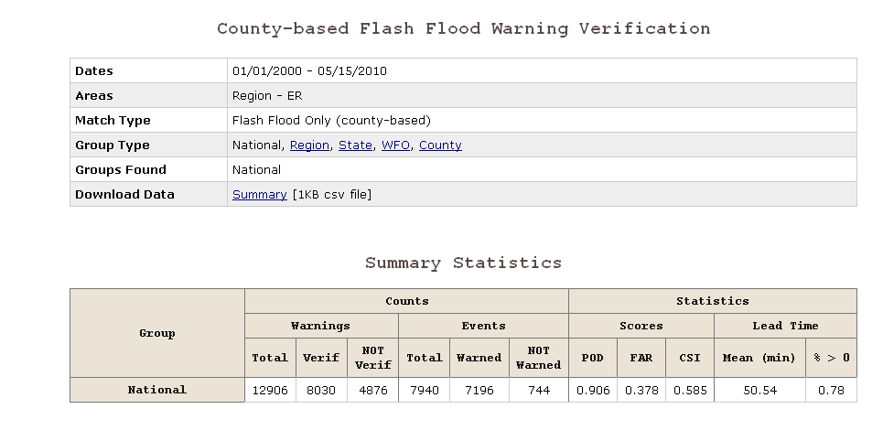
ER FFW Statistics (2000-Present)
* Courtesy of NWS “Stats on Demand” Site
Notes:
Published NWS ER Flash Flood Warning statistics, from Jan. 1, 2000 to May 15, 2010.

Slide 5
ER FFW Statistics (2000-Present)
* Courtesy of NWS “Stats on Demand” Site
Notes:
Same as previous slide, except specific performance metrics (POD, FAR, CSI, and lead time information) are highlighted within a blue rectangle.

Slide 6
ER FFW Stats: POD, FAR, and CSI
Notes:
Line graph, showing published yearly (Jan. 1 to Dec. 31) POD, FAR, and CSI values for Flash Flood Warnings, within the ER of the NWS, from 2000 to 2010. Although POD values have remained fairly constant (near 0.9), FAR numbers have consistently risen since 2006-07. This increase in FAR is responsible for the steady decline in CSI.

Slide 7
ER FFW Stats: Lead-Time Numbers
LT (Minutes): 2000 - Present
Percentage of Zero LT Warnings: 2000 - Present
Notes:
Bar graphs, showing published yearly (Jan. 1 to Dec. 31) Flash Flood Warning LT and percentage of Zero LT statistics, within the ER of the NWS, from 2000 to 2010. LT have persistently increased and the percentage of Zero LT Flash Flood Warnings have persistently decreased this period. However, about 1 out of every 6 Flash Flood Warnings in the NWS ER still has no LT.

Slide 8
Things to Consider
Although overall trends in LT have been good through the last 10 years:
Zero LT Warnings are still running around 15%
About 1 out of every 6 FFW’s
Simply in “reactive mode”
POD has remained exemplary, however:
FAR’s have steadily increased
As a result, CSI’s have lowered over time
What to do ?
Notes:
Main take-home points from quick evaluation of regional Flash Flood Warning performance.

Slide 9
Flash Flood Warning Performance Improvement
Methodology / Data
Notes:
Signals the start of the slides for the “Methodology / Data” section.

Slide 10
Can We Better Differentiate ?
Significant flash flood vs. “nuisance” runoff event
Pre-storm assessments
Warning operations
An established “tool of the trade” for warning decision making
Flash Flood Guidance (FFG) vs. radar estimated / observed rainfall
FFG improvements over time (county-wide values down to gridded basin specific)
What else can we look at ?
Notes:
Both during pre-storm diagnoses and in warning operations, can we better detect the difference between a minor runoff scenario, and a significant flash flood? Part of the warning decision process has traditionally involved using FFG. Are there more skillful parameters/strategies that could be employed?

Slide 11
Looking Back to Go Forward
Previous research by Davis (2000) and Kelsch (2001)
Frequency of short-duration bursts vs. FFG / cumulative rainfall ratios
Main suggestion: Monitoring instantaneous rate trends may be at least as important as using FFG (especially in fast responding watersheds)
Utilized archived data (WES / NCDC) to test this idea
Can the results help us gain skill in flash flood situations ?
Notes:
Davis (2000) and Kelsch (2001) researched the frequency/behavior of heavy rain bursts (short duration spikes in rainfall rates) in certain flash flood situations. They concluded that monitoring rainfall rate trends could prove useful in flash flood warning operations, especially in quick response basins. The work of Davis (2000) and Kelsch (2001) sparked an idea to test this hypothesis for documented flash floods in Central NY and Northeastern PA.

Slide 12
Database
Selected 10 major flash flood events from NY / PA since 2002
Combined costs:
11 fatalities
At least hundreds of millions of dollars in damages
Other numbers:
Warm season cases:
Averaged 6-7” rainfall / 3 hours
Maximum: 10+” on 6/19/07 (Colchester, NY)
Cool season cases (2):
Averaged 2-3” rainfall / 2 hours
Notes:
As the basis for this project, 10 significant flash flood events across Central NY and Northeastern PA were chosen, between 2002 and the present. Not surprisingly, warm season cases displayed significantly higher rainfall rates.

Slide 13
Testing the Hypothesis
For our selected events, we evaluated the following data:
KBGM WSR 88-D
0.5 Degree Base / Composite reflectivity
1-hour estimated instantaneous rates
1-hour, 3-hour, and storm total estimated rainfall
1-hour and 3-hour FFG (MARFC)
Unavailable for one of the cases
Graphically compared the following
Instantaneous rates over time
Ratios of accumulated rainfall to FFG
Notes:
Data sources for the project included reflectivity and precipitation products from the Binghamton, NY (KBGM) WSR-88D, as well as FFG values from the MARFC.

Slide 14
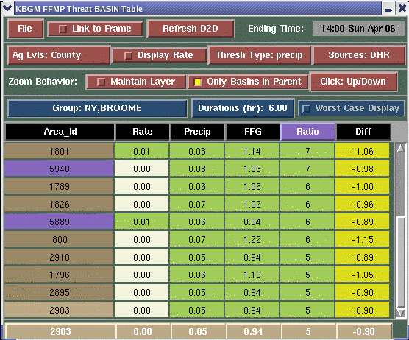
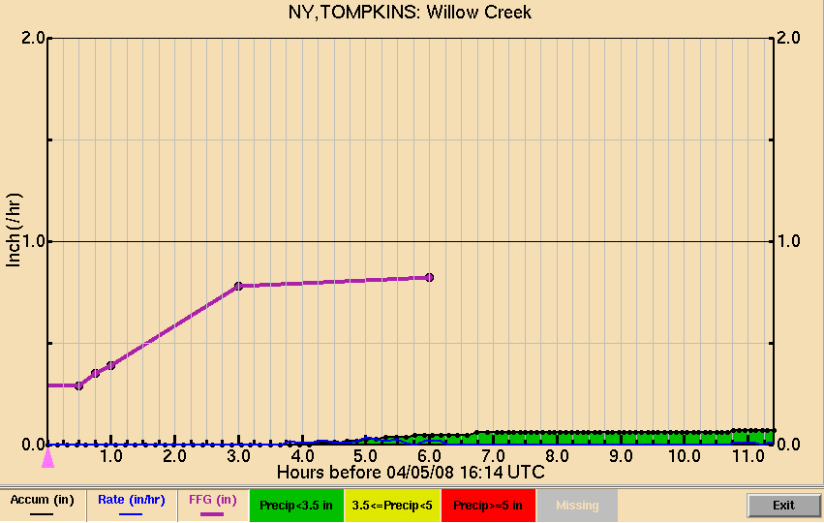
Rainfall Rates and FFMP
Instantaneous hourly rates, accumulated rainfall, and FFG can all be displayed graphically
Rainfall rates tracked every volume scan, basin by basin
Threat Basin Table
Basin Trend Graphs
Notes:
The NWS FFMP program gives warning forecasters the opportunity to view instantaneous hourly rates, both in tabulated form (left), and graphical form (right).

Slide 15
Flash Flood Warning Performance Improvement
Results
Notes:
Signals the start of the slides for the “Results” section.

Slide 16
Heavy Rain Bursts
In the majority of cases (8 / 10), initial reports of major flooding coincided with the third burst of high intensity rainfall
Specific rainfall rates were relative (air mass / season dependent)
Notes:
In most cases, substantial flooding accompanied the third successive spike in precipitation rates, for a given location.

Slide 17
Rates vs. Times Examples
June 19, 2007
January 25, 2010
Notes:
Comparison of two events from the database: a warm season case (6/19/07) and a cool season one (1/25/10). Rainfall rates are graphed over time.

Slide 18
FFW vs. Actual Flooding
1
2
3
3
1
2
June 19, 2007
Black = Major Flooding
Green = FFW Issuance
January 25, 2010
Black = Major Flooding
Green = FFW Issuance
Notes:
Same as in previous slide, with long green and black arrows added. Green arrows represent the times that Flash Flood Warnings were issued, while black arrows represent the times that major flooding was first reported. Successive spikes in rainfall rates were tabulated by the black numerals along the tops of the graphs.

Slide 19
FFW vs. Actual Flooding (LT Issues)
1
2
3
3
Opportunity for more LT ?
Opportunity for more LT ?
1
2
June 19, 2007
January 25, 2010
Notes:
Same data from the last slide. These two cases both illustrate the propensity for significant flooding to accompany the third heavy rain burst for a given event. In hindsight, active monitoring of these trends could have provided the opportunity for additional LT, upon the expectation of an incoming third wave of heavy rainfall.

Slide 20
Rainfall to FFG Ratios
At times when major flooding was reported / observed, mean accumulated rainfall to FFG ratios were:
Warm season
1-hour: 1.45; 3-hour: 1.95
Significant flooding normally occurred well after FFG values were exceeded
Cool season
1-hour: 0.75; 3-hour: 0.9
Significant flooding occurred prior to FFG values being reached
Impervious / frozen surface ?
Notes:
In our database of warm season flash flood events, substantial flooding usually took place when rainfall amounts had already reached 150-200% of FFG values. Conversely, for the cool season cases, flooding developed when rainfall had only reached 70-90% of FFG values. Frozen ground surfaces for the latter cases likely intensified runoff potential, and hastened the development of flooding.

Slide 21
Warm Season Case
3
Major Flooding
1
2
Major Flooding
Rainfall first reaches FFG values
22z, 13 June – 03z, 14 June 2003 (Rate vs. Time)
22z, 13 June – 03z, 14 June 2003 (Rainfall / FFG Ratio vs. Time)
Notes:
In this case example (6/13/03), flash flooding once again accompanied the third spike in high intensity rainfall (left chart). On the right-hand side, it is shown that major flooding was not reported until rainfall amounts had reached 150-250% of FFG values, for that particular drainage basin. Five fatalities resulted from this flash flood in Broome county, NY.

Slide 22
Cool Season Case
Major Flooding
Major Flooding
Rainfall not yet at FFG values
1
2
11z – 17z, 25 January 2010 (Rate vs. Time)
11z – 17z, 25 January 2010 (Rainfall / FFG Ratio vs. Time)
Notes:
In this case example (1/25/10), flash flooding closely corresponded to the third spike in high intensity rainfall (left chart), once again. On the right-hand side, it is shown that major flooding took place when rainfall amounts had only reached about 60-70% of FFG values, for that particular drainage basin.

Slide 23
Flash Flood Warning Performance Improvement
Conclusions / Future Work
Notes:
Signals the start of the slides for the “Conclusions / Future Work” section.

Slide 24
Summary
Timing bursts of high intensity rainfall show promise as a flash flood predictor
At least for higher-end events
Opportunities to combine this kind of diagnosis with analyses of FFG
Sooner recognition of major flooding / better LT ?
Rainfall amounts tend to “rocket” past FFG values for significant warm season flash floods
Possible assistance in warning decision making
Lower FAR’s / better CSI’s ?
Notes:
Main summary points of the presentation: 1) Ascertaining trends in rainfall rates may assist in flash flood prediction. 2) Significant warm season flash floods normally feature rainfall amounts that well eclipse FFG values (at times, they double or triple these values).

Slide 25
Pre-Storm Interrogation
Assessing flash flood potential can be especially difficult in rapidly changing situations
Severe threat evolving to a flash flood threat
Can be tough to switch gears on the fly
Precipitable water (PWAT) can be a fickle parameter
Values can change substantially / quickly as NWP model CPS’s trigger
Another way to view this field ?
Notes:
It can be especially difficult to achieve proper situational awareness in advance of a flash flood scenario, when ongoing severe weather is occurring. Looking at PWAT values on forecast model soundings can be misleading, as this parameter is heavily dependent on whether model convective schemes trigger or not, at a particular site.

Slide 26
Future Work
Maximum potential PWAT (Arnott, 2007) may provide a useful way to assess flash flood potential ahead of time, especially given the expectation of training / repeat cells
Calculates PWAT, assuming a saturated profile along the wet-bulb temperature
May have the advantage of being a more stable value
Needs an automated application to run and the utility itself also has to be tested
Plan to address these issues in the coming months
Notes:
A parameter termed “Maximum potential PWAT” is being developed/tested, in order to provide a more reliable indicator for an ensuing flash flood threat, particularly given the expectation of training/repeat cells. This value is derived, at a specific point, from calculating total column PWAT, assuming saturation along the wet-bulb temperature.

Slide 27
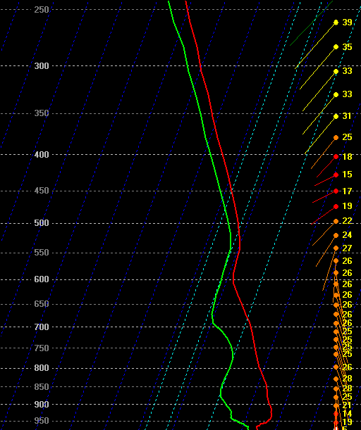
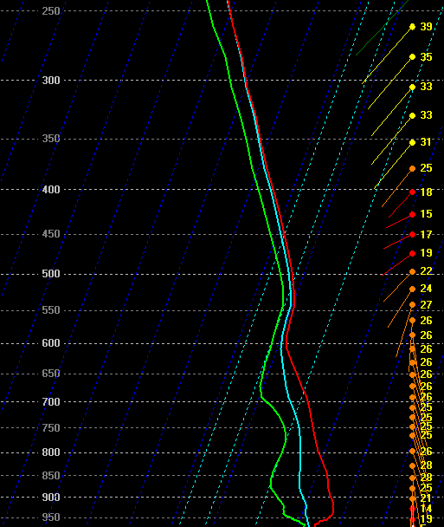
BUFKIT Comparisons
As storms develop/CPS trigger, then depart, model moisture profiles tend to modify quickly
* PWAT could change significantly, hour to hour
Max Potential PWAT values should be less subject to wild fluctuations in time / space
Standard Profile
Max Potential PWAT (saturated along WB temp (light blue trace))
Notes:
Graphical illustration (right) of how Maximum potential PWAT would be calculated.

Slide 28
References
Arnott, J., 2007: Maximum potential precipitable water development and application for forecasting flash flood potential. <http://www.erh.noaa.gov/bgm/research.shtml>.
Davis, R. S., 2000: Detecting flash flood on small urban watersheds. Preprints, 15th Conference on Hydrology, Amer. Meteor. Soc., 233-236.
Kelsch, M., 2001: The relationship between intense, short-duration precipitation and flash floods. Preprints, Symposium on Precipitation Extremes: Prediction, Impacts, and Responses, Amer. Meteor. Soc., 124-128.
Notes:
References cited for this presentation.

Slide 29
The End !!
Questions ??
Notes:
Final slide.

